Slide 1
NLG EVALUATION
Ehud Reiter
http://ehudreiter.com
Sept 2017

Slide 2
Contents
Background: Evaluation and NLG
Experimental design
Types of NLG Evaluation: Task, Ratings, Metric
Commercial evaluation
Case Studies
Q&A

Slide 3
Audience
I assume attendees are familiar with NLG
I assume that most attendees have some experience evaluating NLG systems
Or at least have read about NLG evaluations
I also assume that attendees are not experts at NLG evaluation

Slide 4
Background: Evaluation and NLG

Slide 5
What is evaluation?
Experimentally testing hypotheses about performance
Is system/algorithm/model/etc X better than baseline or state-of-the-art?
Is system/algorithm/model/etc. X useful in real-world applications?
Of course there are many other kinds of hypothesis which we can test
Eg, cognitive modelling

Slide 6
Natural Language Generation
Software which generates texts in English (French, etc.) from semantic representations and/or non-linguistic data
Textual weather forecasts from numerical weather prediction models
Summary for patient from electronic patient record
Financial reports from finance spreadsheets
Etc.

Slide 7
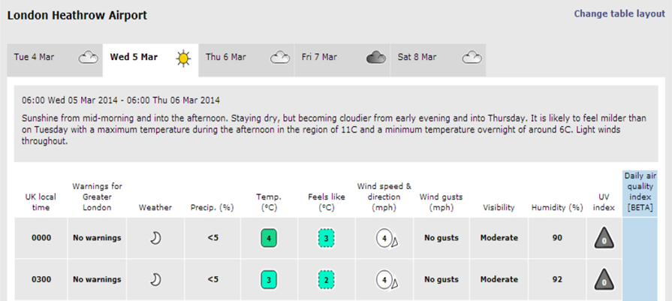
Simple example: Point weather forecast

Slide 8
Complex: BabyTalk
Summarised clinical data about premature babies in neonatal ICU
Input: sensor data; records of actions and observations by medical staff
Output: multi-paragraph texts, summarised data for different audiences

Slide 9
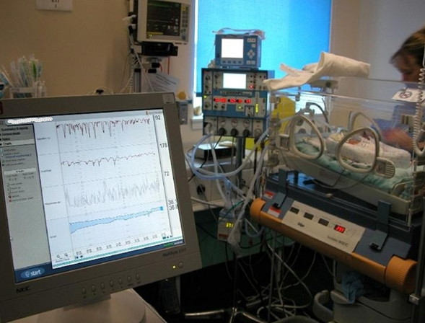
Babytalk: Neonatal ICU

Slide 10
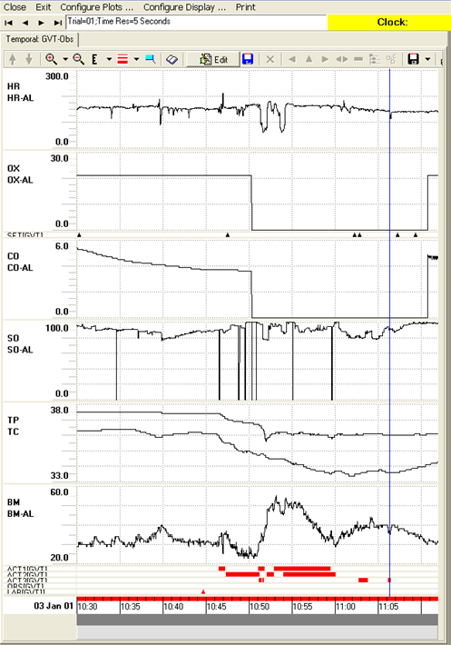
Babytalk Input: Sensor Data

Slide 11
Input: Action Records
Full Descriptor | Time
SETTING;VENTILATOR;FiO2 (36%) | 10.30
MEDICATION;Morphine | 10.44
ACTION;CARE;TURN/CHANGE POSITION;SUPINE | 10.46 - 10.47
ACTION;RESPIRATION;HAND-BAG BABY | 10.47 - 10.51
SETTING;VENTILATOR;FiO2 (60%) | 10.47
ACTION;RESPIRATION;INTUBATE | 10.51 - 10.52

Slide 12
BT45 texts (extract)
Short summary supporting real-time decision making by clinicians
By 11:00 the baby had been hand-bagged a number of times causing 2 successive bradycardias. She was successfully re-intubated after 2 attempts. The baby was sucked out twice. At 11:02 FIO2 was raised to 79%.

Slide 13
BT-Family text (extract)
Page-long text for parents
Yesterday, John was on a ventilator. The mode of ventilation is Bilevel Positive Airway Pressure (BiPAP) Ventilation. This machine helps to provide the support that enables him to breathe more comfortably. Since last week, his inspired Oxygen (FiO2) was lowered from 56 % to 21 % (which is the same as normal air). This is a positive development for your child.
During the day, Nurse Johnson looked after your baby. Nurse Stevens cared for your baby during the night.

Slide 14
BT-Nurse text (extract)
5 page shift handover report for nurses
Respiratory Support
Current Status
…
SaO2 is variable within the acceptable range and there have been some desaturations.
…
Events During the Shift
A blood gas was taken at around 19:45. Parameters were acceptable. pH was 7.18. CO2 was 7.71 kPa. BE was -4.8 mmol/ L.
…

Slide 15
Babytalk evaluations
Different groups interested in different hypotheses and evaluations!
Medics want to know if Babytalk summaries enhance patient outcome
Deploy Babytalk on ward and measure outcome (RCT)
Psychologists want to know if Babytalk texts are effective decision support tool
Controlled “off ward” study of decision effectiveness
Software house wants to know if profitable
Cost, revenue, risks
CS/NLP people want to know how improve system
Qualitative feedback often most useful

Slide 16
Experimental Design

Slide 17
Experimental Design
When designing an experiment (for evaluation or otherwise), we need to decide on
Hypotheses
Subjects
Material
Procedure
Analysis
Get the basics right!

Slide 18
Hypotheses
What hypotheses are we testing?
What do we expect/hope to find
Eg, Users will prefer weather forecasts produced by SuperMet system over forecasts produced by FGen system

Slide 19
Hypotheses in Evaluation Experiments
Evaluation hypotheses are usually about
Utility: System will achieve some effect, such as behaviour change or improved decision making
User satisfaction: Users will like and be satisfied by the system
Similar to humans: System produces texts which are similar to what human writers produce
Other possibilities, eg compute speed (less common)

Slide 20
Hypotheses for weather forecasts
Utility: improved decision making
Weather game: where send ice cream van?
User satisfaction:
Ask users to rate satisfaction on Likert scale
Ask users which forecasts they prefer
Similar to humans
Compare to human forecast using BLEU (etc)

Slide 21
Hypotheses Before Experiment
Decide on hypotheses before you do the experiment!!!
Write them down somewhere
Don’t change/tweak hypotheses to better fit the data
“Results weren’t good, so I loaded data into SPSS and played around until I found something significant”
Invalidates statistical significance tests
If data is better fit to an alternative hypothesis
report as a post-hoc insight, or do another experiment to test this hypothesis.
Don’t say alternative hypothesis supported by data

Slide 22
Example
Hypothesis: Users prefer weather forecasts produced by SuperMet system over forecasts from FGen system
Result
No difference in preference overall
But data suggests that women prefer SuperMet, and men prefer FGen
DON’T say your experiment clearly shows a gender effect
DO say posthoc analysis suggests may be a gender effect
DO run another experiment to explicitly test gender effect
If this exper successful, can say shown gender effect

Slide 23
Experimental Design
When designing an experiment, we need to decide on
Hypotheses
Subjects
Material
Procedure
Analysis

Slide 24
Subjects
If we’re doing experiments on people, who are they?
How many subjects are we looking for?
How do we recruit them?

Slide 25
Who are Subjects?
Subjects should be potential users
If SuperGen generates marine weather forecasts aimed at sailors, don’t ask students to evaluate it!
If SuperGen generates public forecasts, anyone can evaluate it, including students
Ideally subjects should be representative
age, gender, expertise, etc
Can be hard to achieve in practice
You should report subject characteristics
Eg, students between ages of 18-25, 45% female

Slide 26
How Many Subjects?
Ideally numbers based on a statistical power calculation
Algorithm/app which tells you numbers based on your experiment and expected effective size
Eg, SUPERMET Likert ratings are expected to be 0.5 higher than FGEN ratings
Often dont know expected effect size, stan dev
As a very rough rule of thumb, 50 subjects is often a good number in NLG evaluations
Of course depends on the experiment!!

Slide 27
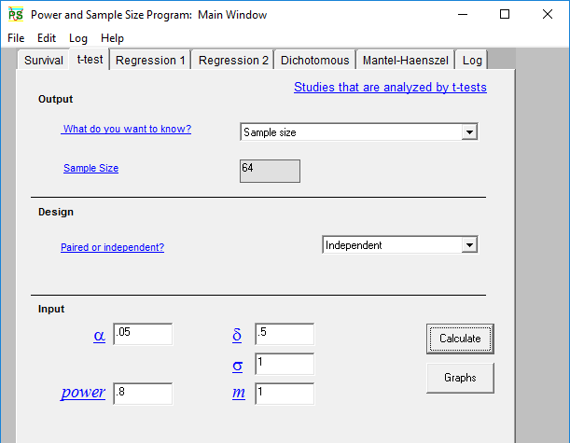
Power calculation (PS)

Slide 28
Subject Recruitment
Easiest way to recruit is Mechanical Turk or similar
Amazon service where you can hire random people to do small tasks very cheaply.
“Task” is participating in your experiment
Many alternatives to Amazon
Works *if* Turkers are potential users, real-world context isn’t needed, and you don’t need to observe or debrief subjects

Slide 29
Subject Recruitment
Can recruit friends, colleagues, social network
Free (unlike Mturk)
Are they potential users, etc?
Can you get enough subjects?
Will they be biased because they know the outcome you hope to achieve?
Do they know SuperMet is your creation?

Slide 30
Subject Recruitment
Explicit recruitment of subjects
Target exactly the kind of subject you want
Via contacts, bulletin boards, advertisements, professional conferences, …
Often takes a lot of time and effort…

Slide 31
Experimental Design
When designing an experiment, we need to decide on
Hypotheses
Subjects
Material
Procedure
Analysis

Slide 32
Material
Usually our experiments are based on scenarios, which are defined by a set of input data
For each scenario, we produce an output text from the system we are evaluating and from the controls
What systems do we look at?
How do we choose scenarios?
Random choice? Try to cover varied data sets?
How many scenarios do we need?

Slide 33
Simple scenario
Output text
Input data

Slide 34
Which Systems?
Usually want to compare our NLG system to other sys
Which comparison systems do we use?
Baseline: ideally state-of-the-art existing system
Eg, compare SuperMet to best existing weather forecast generator (FGen)
Topline: good-quality human texts?
Create scenario texts for each system
Eg, create SuperGen, FGen, human text for each scenario data set

Slide 35
How do we choose scenarios?
Easiest approach is to randomly select data sets
But this means that we’ll have lots of examples of common cases, and few examples of unusual cases
Handling edge cases is important for quality
Eg, SuperGen when there are gale-force winds
Unlikely to be in randomly selected data set
Alternative is to look for diverse data sets, including important edge cases
Ie, explicitly include gale-force wind scenario(s)

Slide 36
Which Scenarios?
Example strategy for evaluating SuperGen: Choose
4 forecasts for boring days
4 forecasts for days with lots of rain
4 forecasts for days with strong winds
8 additional forecasts (random)
Within each category, choose at random
Ensures we have coverage of rainy/windy days

Slide 37
How Many Scenarios?
As many as possible, provided that all of the scenarios are seen an appropriate number of times.
Eg, if 50 subjects each look at 4 scenarios, and we want each scenario seen by 10 subjects, then we should have 20 scenarios
As a very rough rule of thumb, many experiments do use on the order of 20 scenarios
Of course depends on the experiment!!

Slide 38
Experimental Design
When designing an experiment, we need to decide on
Hypotheses
Subjects
Material
Procedure
Analysis

Slide 39
Procedure
What do we ask subjects to do with the material, and what do we measure?
High-level choices
Human evaluation vs automatic metric
Task/outcome based vs ratings based
Artificial lab context vs real-world context
Discussed later

Slide 40
Which texts do Subjects See?
Lets say we have 20 scenarios, and three texts for each
Baseline, system, human-written topline
60 texts in all
Assume we have 60 subjects, which look at 3 texts each
What does each subject see?
Randomly choose from 60 texts?
Subj 31 sees 7-baseline, 15-baseline, 16-system
Show each subject all 3 variants of one text?
Subj 31 sees 7-baseline, 7-system, 7-topline
Latin square – balance design (my favourite)

Slide 41
Latin Square
 | Scenario 1 | Scenario 2 | Scenario 3
Subject 1 | SuperMet | Human | FGen
Subject 2 | FGen | SuperMet | Human
Subject 3 | Human | FGen | SuperMet

Slide 42
Procedure: Other
Practice scenarios: Can give subjects some practice scenarios which we do not record
Especially useful if we are timing people, since people are usually slower the first time
Exclusion: May drop subjects who don’t seem to be taking the experiment seriously
As determined by an objective criteria, such as correct response to trivial question

Slide 43
Procedure: Ethics
Subjects must give informed consent
Subjects can drop out at any time
Can NOT pressure them to stay if they want to quit
Data is anonymised
Can experiment harm someone?
Can subject be harmed?
Can text hurt someone else (medical decision support)
If possible, must present acceptable solution
Most universities have ethics panels which assess and approve procedures from an ethical perspective

Slide 44
Experimental Design
When designing an experiment, we need to decide on
Hypotheses
Subjects
Material
Procedure
Analysis

Slide 45
Analysis
We have the data, how do we analyse and report it?
What statistics do we use
How do analyse and report free-text comments?
Error analysis

Slide 46
Statistical Hypothesis Testing
Quick review, assume people know this
We test the “null hypothesis” that there is no difference between the systems we are evaluating
Eg, null hypothesis is that there is no difference in user preference between SuperGen and FGen.
Some people prefer SuperGen, but just as many prefer Fgen
How likely is observed data if null hypothesis is true?

Slide 47
Statistical Hypothesis Testing
Suppose we ask 10 subjects which they prefer?
What if 6 of our subjects prefer Supergen
Cannot reject null hyp, maybe we just happened to choose 6 people who liked Supergen
What if 9 of our subjects prefer Supergen
This is pretty unlikely if null hyp is true, so can reject
P values give likelihood of observation if null hyp true
Usually say null hyp rejected if p < .05

Slide 48
Statistical Hypothesis Testing
Suppose we have a bag containing lots of white and black marbles.
Null hypothesis: equal number of white and black marbles
What if we pick 10 marbles, and 6 of these are black?
Cannot reject null hypothesis
What if we pick 10 marbles, and 9 of these are black?
This is pretty unlikely if null hyp is true, so can reject

Slide 49
Statistical Test
Many different statistical tests!
However, there are standard ones for common types of hypotheses
Described in subsequent slides
Use these unless you have good reason not to!
Which is explained in your write-up

Slide 50
Analysis: comparison of mean
Is the average (mean) of something (user rating, time to make decision) different between the main system and the control/comparison systems
Do users give higher Likert ratings to SuperMet forecasts than to FGen forecasts?
Use t-test when comparing means of two systems
Eg, SuperMet text ratings vs FGen text ratings

Slide 51
Comparison of mean
Use ANOVA when comparing means of more than two systems
Eg SuperMet vs FGen vs Human ratings
Supplement with Tukey HSD post-test to identify significant differences between individual pairs
ANOVA will say there is a sig diff somewhere.
Tukey HSD will say there is a sig diff between SuperMet and FGen, but not between SuperGen and Human.

Slide 52
Comparison of mean
Use General Linear Model to look at multiple factors that influence the mean
Eg, build model which predicts rating based on system (eg, SuperGen), subject (Fred, who is very generous in his ratings), and scenario (eg, data set 1, which is difficult to describe in words)
Useful to separate impact of system from impact of other factors

Slide 53
Comparison of Means
Mann-Whitney and Wilcoxon Signed Rank are non-parametric tests
More robust and conservative than t-test
Only occasionally used in NLP

Slide 54
Comparison of categorical outcome
Use chi-square test to see if users of system X more likely to be in a certain category than users of system Y
Eg, if we compare two systems for encouraging smoking cessation, are users of the first system more likely to quite than users of the second system?
If 5 out of 100 users of my system stopped smoking, but only 4 out of 100 users of other system stopped smoking, is this significant?
Categories are {StillSmoking, QuitSmoking}

Slide 55
Correlations
If we have two measurements, does an increase in the first measurement mean that the second is also likely to increase (or decrease)?
Eg, if we ask subjects to rate texts on both readability and usefulness, does a higher readability score usually imply a higher usefulness score?
Two common correlations
Pearson (most common)
Spearman (non parametric)

Slide 56
Doing Stats Right
Decide on and write down your statistical analysis before you do the experiment (same as hypotheses)
Posthoc “tweaked” analyses must be reported as such!
If you are testing more than one hypothesis, reduce p value accordingly
Eg if testing 100 hypotheses, look for p < .0005 instead of p < .05
p < .05 means 5% chance of incorrectly rejected null hyp
So if testing 100 hyp, will make 5 mistakes!
Always report 2-tailed p values

Slide 57
Free-text comments
Good practice to ask subjects to give free-text comments after an experiment
Useful for understanding why things (did not) work!
Ratings just tell us that users liked SuperMet forecasts
Comments tell us why they liked SuperMet
Analysis should include summary of free-text comments
No standard methodology for how to do this
Repeat particularly insightful comments?
Categorise comments (eg, content vs wording), report numbers in each category?

Slide 58
Error Analysis
Good practice to identify scenarios where a system did poorly, and analyse why this happened
Eg, users gave SuperMet poor ratings in a scenario with very high temperatures
Free-text comments complained SuperMet forecast did not highlight potentially dangerous temperature
SuperMet needs to do a better job of describing high-temperature scenarios and dangers
No standard methodology

Slide 59
Coda: Concerns about experimental design
Concerns in wider scientific community about experiments
Statistically significant results should be repeatable
Results reflect underlying truth, not experimental noise
So other researchers will see the same thing
But many “significant” findings are not replicable!
Medicine/biology: only 6 out of 53 important cancer studies could be replicated (11%)
Psychology: 36% success rate in replications
Can we trust experimental findings? Can we trust science?

Slide 60
What Studies are Replicable?
Good experimental design
Eg, Randomised controlled clinical trial
Multiple-hypothesis corrections
If you test 100 false hypotheses, 5 will seem significant at p < .05
No posthoc tweaking of hypotheses, stats, etc
Publish on a website *before* the experiment
Bad sign: field is “hot”
hotness encourage sloppy science

Slide 61
Scientific Culture
Ioannidis: Replication problems more likely in fields where
Few negative results reported
Significance-chasing behaviour
My first hypothesis was not significant, so I’ll just tweak hypothesis and stats until I get a significant result
Underpowered studies
Unfortunately, NLP meets above criteria…

Slide 62
Hypothesis Testing
Remember that you are testing hypotheses when you evaluate a system
Remember that poor hypothesis testing (because of poor experimental design) is meaningless.

Slide 63
Types of Evaluation Task, Human, Metric

Slide 64
Evaluation Procedures
Task/outcome based
Does the NLG system help users perform a task, or change their behaviour?
Ratings/opinion based
Do users like texts produced by the NLG system?
Metric based
Are the NLG texts similar to human-written texts?
Evaluate in real world or in laboratory experiment

Slide 65
NLG Evaluations
 | Task | Ratings | Metric
Real-world | Stop | BT Nurse | NA
Laboratory | BT 45 | Sumtime | weather

Slide 66
Task/Outcome Evaluation
Extrinsic evaluation
Measure whether NLG system achieves its goal
Better decision making
Better clinical outcome
Behaviour change
Etc.
Evaluate in real world or in laboratory experiment

Slide 67
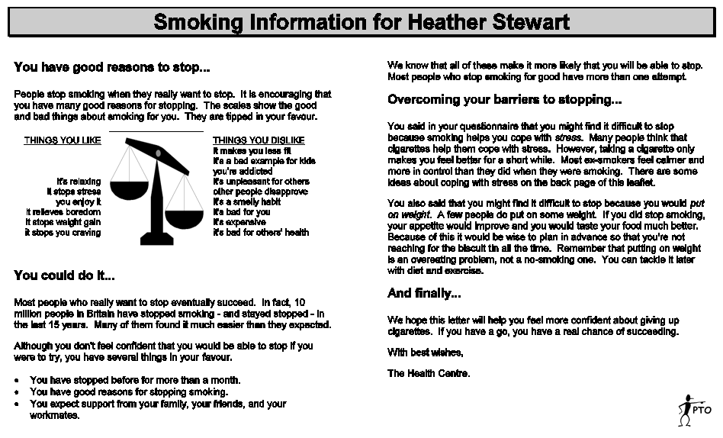
Real world: STOP smoking
STOP system generates personalised smoking-cessation letters

Slide 68
STOP experimental design
Hypothesis: STOP users more likely to quite than controls
Subjects: recruited 2553 smokers
Approached all smokers registered with a set of GPs
1/3 agreed to participate
Material
Three “systems”: STOP, fixed (non-tailored) letter, simple “thank you” letter
STOP letter personalised for each subject, other letters were fixed

Slide 69
STOP experimental design
Procedure
Subjects fill out smoking questionnaire
Subjects receive STOP, non-tailored, or thank-you letter
After 6 months, ask subjects if they have stopped smoking
Verify with saliva sample
Statistics: Chi-square to compare cessation rates in the different groups

Slide 70
STOP: result
6-Month cessation rate
STOP letter: 3.5%
Non-tailored letter: 4.4%
Thank-you letter: 2.6%
Note:
More heavy smokers in STOP group
Heavy smokers less likely to quit

Slide 71
Comment: Negative result
We published as a negative result
Negative results can and should be published!
Ioannidis: lack of negative results is a very bad sign
Negative results can be published: STOP result published in ACL, BMJ, AI Journal
Publish the result of your experiment, even if it isn’t the result you were looking for!

Slide 72
References
E Reiter, R Robertson, and L Osman (2003). Lessons from a Failure: Generating Tailored Smoking Cessation Letters. Artificial Intelligence 144:41-58
AS Lennox, LM Osman, E Reiter, R Robertson, J Friend, I McCann, D Skatun, and P Donnan (2001). The Cost-Effectiveness of Computer-Tailored and Non-Tailored Smoking Cessation Letters in General Practice: A Randomised Controlled Trial. British Medical Journal 322:1396-1400

Slide 73
Laboratory task evaluation
Real-world task evaluation is “gold standard” evaluation in many fields, including medicine
But expensive, and can raise ethical issues
Also can be hard to compare alternatives in a controlled way
Alternative is laboratory task evaluation

Slide 74
Laboratory evaluation: BT45
Babytalk BT-45 provided decision support to clinicians making decisions about care of premature babies in neonatal ICU
By 11:00 the baby had been hand-bagged a number of times causing 2 successive bradycardias. She was successfully re-intubated after 2 attempts. The baby was sucked out twice. At 11:02 FIO2 was raised to 79%.

Slide 75
BT45 experimental design
Hypothesis: Clinicians make better decisions from BT45 texts than from standard data visualisations
Subjects: 35 NICU clinicians, junior nurses to senior doctors
Balanced for expertise, not age or gender
Material
24 data sets (scenarios) from historical data
3 examples of 8 conditions
Created 3 presentations of each data set (scenario)
BT45 text, Human text, Visualisation

Slide 76
BT45 experimental design
Procedure: Asked clinicians to look at a presentation and choose intervention (in 3 min)
In experiment room, not in ward!
Compared intervention to gold standard
Decided upon by expert clinicians, no time limit
Latin square design
Analysis: Compare mean decision quality between BT45, human, and visualisation conditions (ANOVA)
Different measures of decision quality

Slide 77
Results: BT45
Correct (gold-standard) decision made (simplified scoring)
BT45 text: 34%
Human text: 39%
Visualisation: 33%
No significant difference between BT45 and Visualisation

Slide 78
Comment: Edge cases matter
Error analysis: BT45 texts mostly as good as human, but were did poorly when desired intervention was “no action” or “reattach sensors”
System needs to perform well in all cases
“reattach sensor” as well as “increase oxygen level”
In NICU, “no action” is probably most common decision, needs to be handled well!

Slide 79
References
F Portet, E Reiter, A Gatt, J Hunter, S Sripada, Y Freer, C Sykes (2009). Automatic Generation of Textual Summaries from Neonatal Intensive Care Data. Artificial Intelligence 173:789-816
M. van der Meulen, R. Logie, Y. Freer, C. Sykes, N. McIntosh, J. Hunter (2008). When a graph is poorer than 100 words: a comparison of computerised natural language generation, human generated descriptions and graphical displays in neonatal intensive care. Applied Cognitive Psychology, 24:77-89

Slide 80
Task/outcome (extrinsic) evaluations
Most respected
Especially in broader scientific community
Expensive and time-consuming
Evaluation is of specific system, not generic algorithm or idea
Small changes to BT45 (STOP?) would have significantly changed evaluation result

Slide 81
Human Ratings
Ask human subjects to assess texts
Readability (linguistic quality)
Accuracy
Usefulness
Often use Likert scale
Strongly agree, agree, undecided, disagree, strongly disagree
Alternative is for subjects to rank texts on above criteria
Eg, rank SuperGen, Fgen, Human forecast on usefulness

Slide 82
Why use ratings?
Task success criteria are hard to measure
Humour, entertainment
Public weather forecast
“ice cream test” is just one use case
etc
Want subjects to focus on generalise beyond a specific systems
Task evaluation is too expensive, time-consuming, etc

Slide 83
Real world: BT-Nurse
BT-Nurse generated shift handover reports for NICU nurses
Respiratory Support
Current Status
…
SaO2 is variable within the acceptable range and there have been some desaturations.
…
Events During the Shift
A blood gas was taken at around 19:45. Parameters were acceptable. pH was 7.18. CO2 was 7.71 kPa. BE was -4.8 mmol/ L.

Slide 84
BT-Nurse: Experimental Design
Hypothesis: NICU nurses will find BT-Nurse texts to be understandable, accurate, and helpful
Not measuring medical outcome
Subjects: NICU nurses
165 trials, where a nurse read a BT-Nurse texts
54 nurses, most participated in multiple trials
Material: BT-Nurse texts
No control/baseline

Slide 85
BT-Nurse: Experimental Design
Procedure (for incoming nurses)
Research nurse vetted BT-Nurse text, to screen out texts which could harm patient care (ethics)
In fact no BT-Nurse texts were screened out
Duty nurse read BT-Nurse text
Nurse rated texts understandable, accurate, helpful (3-pt)
Analysis
Percentage of nurses that rated texts understandable, etc
Use chi-square for significance
Quantitative summary of free-text comments

Slide 86
BT-Nurse: Results
Numerical results
90% of texts understandable
70% of texts accurate
60% of texts helpful
[no texts rejected as potentially harmful]
All numbers are statistically significant
Many free-text comments
Most common was request for more content
A few “really helped me” comments
Some comments highlighted software bugs

Slide 87
Comments: Fix the bugs!
Fix the bugs before you evaluate!
“Boring” engineering, but you’ll get poor results if you don’t
Note BT-Nurse bugs impacted ratings, but did not damage patient care
Babytalk was a university research project
Arria puts a lot of effort into testing and quality assurance!

Slide 88
References
J Hunter, Y Freer, A Gatt, E Reiter, S Sripada, C Sykes, D Westwater (2011). BT-Nurse: Computer Generation of Natural Language Shift Summaries from Complex Heterogeneous Medical Data. Journal of the American Medical Informatics Association 18:621-62
J Hunter, Y Freer, A Gatt, E Reiter, S Sripada, C Sykes (2012). Automatic generation of natural language nursing shift summaries in neonatal intensive care: BT-Nurse. Artificial Intelligence in Medicine 56:157–172

Slide 89
Laboratory ratings evaluation
Laboratory study can be cheaper and quicker
Easier to compare alternatives in a controlled way

Slide 90
Laboratory experiment: Sumtime
Marine weather
forecasts

Slide 91
Sumtime: Experimental Design
Hypothesis: Users prefer SumTime texts over human texts
Subjects: 73 people who read marine forecasts
Recruited via contacts
Material
Chose 5 weather data sets (scenarios) from historical data
Created 3 presentations of each scenario
Sumtime text
Human texts (actual forecaster text)
Hybrid: Human content, SumTime language
Want to assess value of microplanning without doc planning

Slide 92
Sumtime: Experimental Design
Procedure
Subjects shown 2 of the 3 possible variants of a scenario
Asking which variant was more readable, most accurate, most appropriate
Online or on Word document (hard copy or electronic)
Sailors could fill out whilst at sea
Analysis
Chi-square to see if preferences significant

Slide 93
Results: Sumtime
SumTime vs. human texts
Question | SumTime | Human | same | p value
More appropriate? | 43% | 27% | 30% | 0.021
More accurate? | 51% | 33% | 15% | 0.011
Easier to read? | 41% | 36% | 23% | >0.1
Hybrid vs. human texts
Question | Hybrid | Human | same | p value
More appropriate? | 38% | 28% | 34% | 0.1
More accurate? | 45% | 36% | 19% | 0.1
Easier to read? | 51% | 17% | 33% | >0.0001

Slide 94
Comment: Better Than Human!
NLG systems can produce texts which are better than human texts!
I.e. better than texts written by humans of average ability writing under time pressure
Exciting!
Finding has been replicated
Unusual in NLP

Slide 95
References
E Reiter, S Sripada, J Hunter, J Yu, and I Davy (2005). Choosing Words in Computer-Generated Weather Forecasts. Artificial Intelligence 167:137-169.

Slide 96
Laboratory ratings evaluation
Probably most common type in NLG
Easiest and quickest
Well accepted in NLP literature
Less well accepted outside NLP
Don’t try to publish this in a medical journal/conference!
We know these may disagree with results of task performance eval!
Earlier Babytalk experiment, comparing text to visualisation
Doctors preferred visualisations
Doctors made better decisions from text

Slide 97
Human Evaluations
 | Task | Ratings
Real-world | Most meaningful | intermediate
Laboratory | intermediate | Least meaningful
 | Task | Ratings
Real-world | Most expensive | intermediate
Laboratory | intermediate | Cheapest

Slide 98
Metric-based evaluation
Create a gold standard
Input data for NLG system (scenarios)
Desired output text (usually human-written)
Ideally multiple “reference” texts specified
Run NLG system on above data sets
Compare output to gold standard output
Various metrics, such as BLEU
Widely used in machine translation

Slide 99
Metric evaluation: Experimental Design
Hypothesis: System A texts more similar to gold standard texts than system B texts
Subjects: none
Material: Scenarios and gold standard texts
Ideally multiple gold standard texts for each scenario, since information can be communicated in several ways
Procedure: Use scoring metric such as BLEU
Statistics: specialised

Slide 100
Example: SumTime input data
Day/ Hour | Wind Direction | Speed | Gust
05/06 | SSW | 18 | 22
05/09 | S | 16 | 20
05/12 | S | 14 | 17
05/15 | S | 14 | 17
05/18 | SSE | 12 | 15
05/21 | SSE | 10 | 12
06/00 | VAR | 6 | 7

Slide 101
Example: Gold standard
Reference 1: SSW’LY 16-20 GRADUALLY BACKING SSE’LY THEN DECREASING VARIABLE 4-8 BY LATE EVENING
Reference 2: SSW 16-20 GRADUALLY BACKING SSE BY 1800 THEN FALLING VARIABLE 4-8 BY LATE EVENING
Reference 3: SSW 16-20 GRADUALLY BACKING SSE THEN FALLING VARIABLE 04-08 BY LATE EVENING
Above written by three professional forecasters

Slide 102
Metric evaluation example
SumTime output:
SSW 16-20 GRADUALLY BACKING SSE THEN BECOMING VARIABLE 10 OR LESS BY MIDNIGHT
Compare to Reference 1
SSW’LY 16-20 GRADUALLY BACKING SSE’LY THEN DECREASING BECOMING VARIABLE 4-8 10 OR LESS BY LATE EVENING MIDNIGHT
Compute score using metric
edit distance, BLEU, etc

Slide 103
Issues
Does similarity to gold-standard mean better for readers?
Is SSW’LY better than SSW?
2 out of 3 reference texts use SSW
Need to have multiple reference texts
Is BY LATE EVENING better than BY MIDNIGHT?
User studies with forecast readers suggest BY MIDNIGHT is less ambiguous
Should SumTime be evaluated against human texts?
SumTime texts are better than human texts!

Slide 104
Are metrics meaningful?
Assess by validation study
Do “gold standard” evaluation of multiple NLG systems
Task-performance or human ratings
Ideally evaluate 10 or more NLG systems
Which must have same inputs and target outputs
Also evaluate systems using metrics
Which metric correlates best with “gold standard” evaluations?
Do any metrics correlate?

Slide 105
Validation Study: Experimental Design
Hypothesis: BLEU, other metrics correlate with human ratings
Subjects: 14 people who regularly read marine forecasts
Similar to SumTime subjects
Material: Forecast texts produce by 6 marine forecast generators, plus the human forecast text, for 14 scenarios
Procedure: Subjects rated texts on Clarity and Accuracy
Latin square design
Analysis: Correlation (Pearson) between metrics and human ratings of the different system

Slide 106
Validation: result
Clarity (readability): Best predicted by NIST-5 (BLEU variant)
Statistically significant correlation using “generous” stats
1-tailed, no multiple hypothesis correction
Not significant under “conservative” stats
2-tailed, multiple hypothesis correction
Accuracy: Not predicted by any metric
No correlation is significant, no matter how calculated

Slide 107
References
E Reiter and A Belz (2009). An Investigation into the Validity of Some Metrics for Automatically Evaluating Natural Language Generation Systems. Computational Linguistics 35:529–558

Slide 108
Metric-based evaluation
I lack confidence in metric-based evaluation of NLG systems
I want to see validation studies that show
statistically significant correlation of 0.8 (or more)
Significant with conservative statistics
Against high-quality human evaluation
Real-world and/or task-based
With clarity about scope
Only valid when comparing statistical NLG systems?
Only valid in newswire genre?

Slide 109
Commercial Evaluation

Slide 110
Commercial Evaluation
Contractual
Cost
Benefits
Risks
Poorly understood!

Slide 111
Contractual
Does the system meet the contractual requirements?
Assessed by User Acceptance Test (UAT)
Won’t further discuss here

Slide 112
Cost
Cost of system
Life cycle: Development, testing, maintenance
Does statistical NLG reduce cost?
Claims that system can be developed (built) quicker using statistical NLG
Very hard to rigorously test such hypotheses
Lots of confounds: team skill, enthusiasm, background
What about testing and maintenance?
statistical NLG easier/ harder than rule-based?
“please change rainy day to wet day in the computer-generated forecasts”

Slide 113
Benefits
Quantitative
Better task performance, reduced costs due to automation, etc.
Qualitative
“Arria’s report generation system saves money, but even more important is that it improves consistency”
Very important, even if hard to measure
Uptake
Will people use the system?
Medicine: very poor uptake of decision support
Change management

Slide 114
Risks
Low-probability, high-impact events
Skillsum (assessment feedback) user starts crying when she sees the feedback
Poor baby care due to bad BT-Nurse advice?
Undesirable side effects
“Adding localised weather forecasts to my website will help my users, but I am worried my Google search rank will go down”
How do we measure/ evaluate these?

Slide 115
Worst-Case performance
We need to understand the impact when a system performs really badly
Not just performance on average
Focus of academic evaluations

Slide 116
Case Studies

Slide 117
Case Study 1: UK Public Forecasts
Arria system which created public weather forecast texts.
Supplement standard weather graphics

Slide 118
Evaluation
System was deployed on UK Met Office “Invent” ( beta software) web site
Users could be asked to respond after reading a forecast.
How can we evaluate the forecast generator in this context?

Slide 119
Experimental Design
Hypotheses
Subjects: had to be genuine users who came across system. Not allowed to recruit subjects
Material
Procedure
Analysis
Actual experiment
http://www.aclweb.org/anthology/W14-4401

Slide 120
Actual experiment
Hypotheses: Users value forecast texts as useful supplement to standard weather graphics
Subjects: naturally occurring (35 people)
Material: forecast and graphics, for any UK location
Procedure: respond to three questions
helpfulness, length, would you recommend
Analysis: Percentage of responses (no stats or p value)

Slide 121
Results
97% found the text to be helpful
74% thought length was about right
91% would recommend texts be included in local public forecasts

Slide 122
Case Study 2: Public Forecasts in Galicia
Public forecasts for Galicia (including Santiago)

Slide 123
Evaluation
Ask forecasters to assess quality of forecasts

Slide 124
Experimental Design
Hypotheses
Subjects: forecasters
Material
Procedure
Analysis
Actual experiment
https://www.researchgate.net/publication/266317013_Linguistic_Descriptions_for_Automatic_Generation_of_Textual_Short-Term_Weather_Forecasts_on_Real_Prediction_Data

Slide 125
Actual experiment
Hypotheses: Weather forecasters think forecasts are high quality
Subjects: 1 forecaster
Material: 45 datasets and computer-gen forecasts
Procedure: respond to several questions
Analysis: mean and standard deviation (no p value)

Slide 126
Results
Indicate in which degree you identify the type of results expressed as the type of results expressed by yourself:
Sky cover: 5 (5 is maximum value)
Precipitation: 5
Wind: 5
Temperature 5
Do you agree with the provided descriptions:
Sky cover: 4.97
Precipitation: 4.53
Wind: 5
Temperature 5
Indicate in which degree the vocabulary is used correctly: 5
Indicate in which degree the content is correctly grouped to facilitate the comprehension of the description: 4.64
Indicate in which degree the format of the report, including the punctuation, is the most adequate: 4.53

Slide 127
Case Study 3: Error Analysis in Image Desc
Automatic generation of descriptions/captions for images

Slide 128
Evaluation
Analyse the type of errors made by an existing image description algorithm

Slide 129
Experimental Design
Hypotheses: none
Subjects
Material
Procedure
Analysis
Actual experiment
https://arxiv.org/abs/1704.04198

Slide 130
Actual experiment
Hypotheses: none
Subjects: 2 annotators
Material: 1014 generated descriptions of Flickr images
Procedure:
Develop annotation scheme for types of errors
Annotate descriptions under this scheme
Analysis: annotation frequency; inter-annotator agreement

Slide 131
Results
Interannotator agreement: 55% on precision/recall basis

Slide 132
Concluding Thoughts

Slide 133
Summary
Many ways to evaluate NLG
Task-based (real-world or laboratory)
Human ratings (real-world or laboratory)
Metrics
Commercial (poorly understood)

Slide 134
Which technique to use?
Most common is laboratory ratings
Task-based and/or real-world evaluation is harder, but more meaningful.
Metrics should not be only evaluation
Good experimental design and statistics!
Getting the basics right is most important thing!

Slide 135
Challenges
Education and spread of best practice
Commercial evaluation
How do we measure costs, benefits, risks?
Design cheap/quick human evaluation that correlate with high-quality human evaluation
Well-validated metrics

Slide 136
Personal Lessons
Publish negative results
Edge cases and outliers matter
Make sure code is debugged
Validate metrics
Look at risks and worst-case performance
Not rocket science
But very important

Slide 137
References
I have several blogs about evaluation on ehudreiter.com

Slide 138
Evaluation in NLG/NLP
Lets do it properly and rigorously, with replicable results!
Otherwise its not science

